Slide 1
Safe Search Engines
Survivor : Media Review
Mixed Teams- Collaborative Work

Slide 2
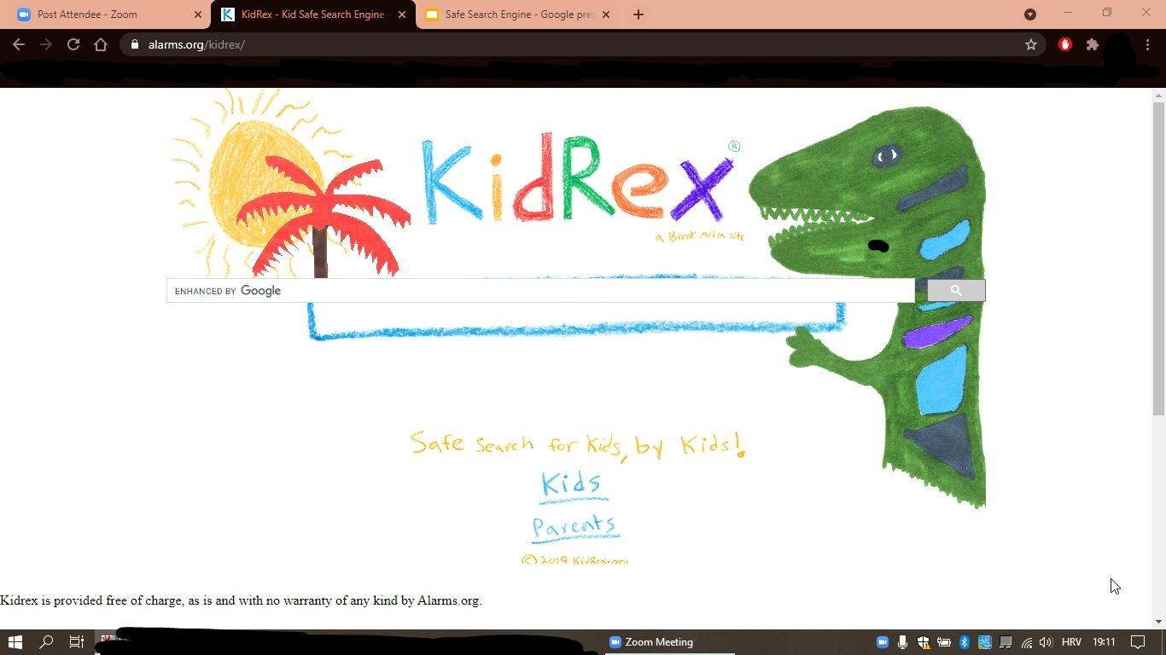


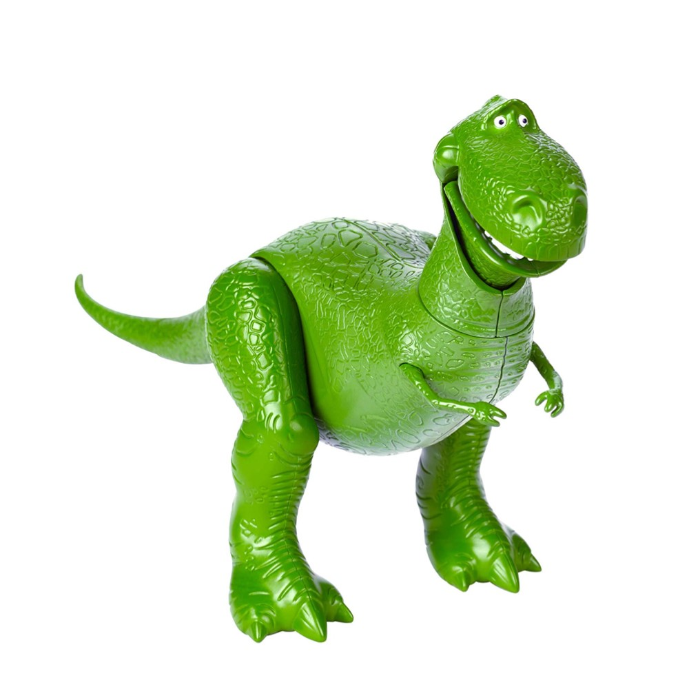
Kidrex/ Ana & Tuğba
KidRex - Kid Safe Search Engine - Now powered by Alarms.org
Kayak = a light narrow boat that has both ends tapered to a point, is propelled by a double-bladed paddle, and often has a closed top except for an opening in which the paddler sits with the legs extended straight out in front

Slide 3

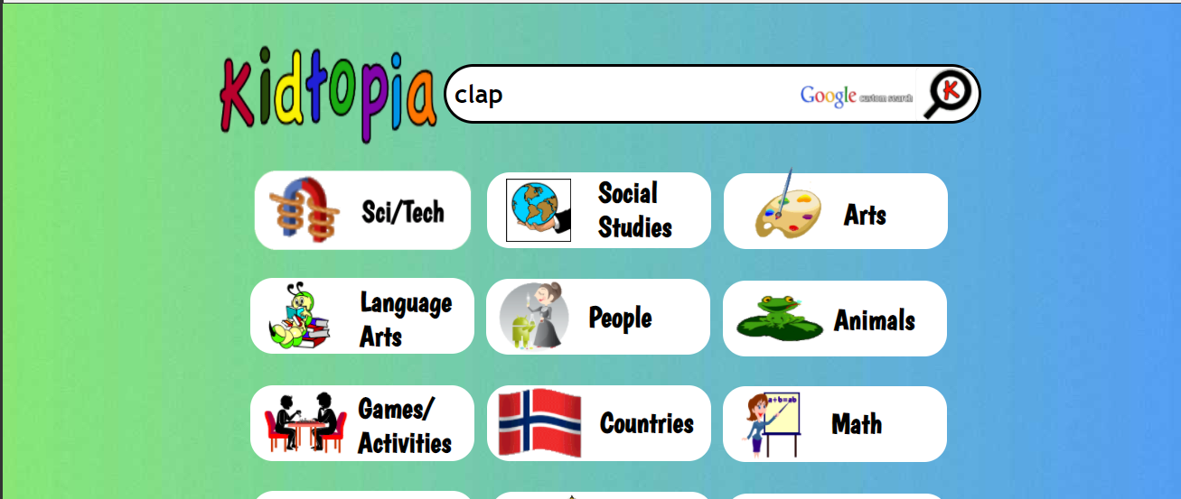
Kidtopia/ Anda & Burhan
CLAP:to bring two hands together forcefully, creating a sharp sound

Slide 4


Duck Duck Go / Denis & Esther
Duck Duck Go Search engine -
https://duckduckgo.com/
Any of numerous insects of the order Lepidoptera, generally distinguished from butterflies by their nocturnal activity, hairlike or feathery antennae, stout bodies, and the frenulum that holds the front and back wings together.

Slide 5

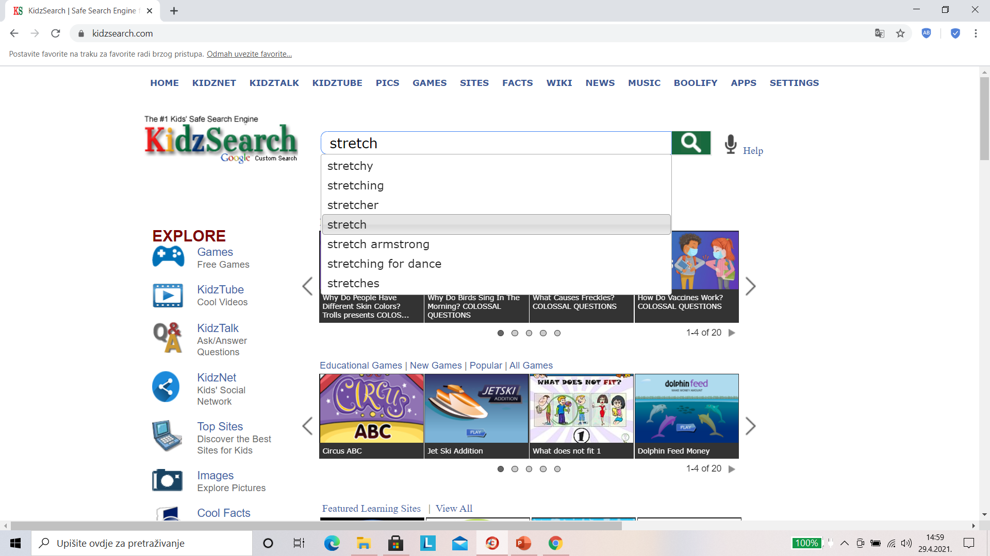
Kidzsearch / Fatma & Josipa
stretch=
an act of stretching one's limbs or body;
a continuous area or expanse of land or water

Slide 6

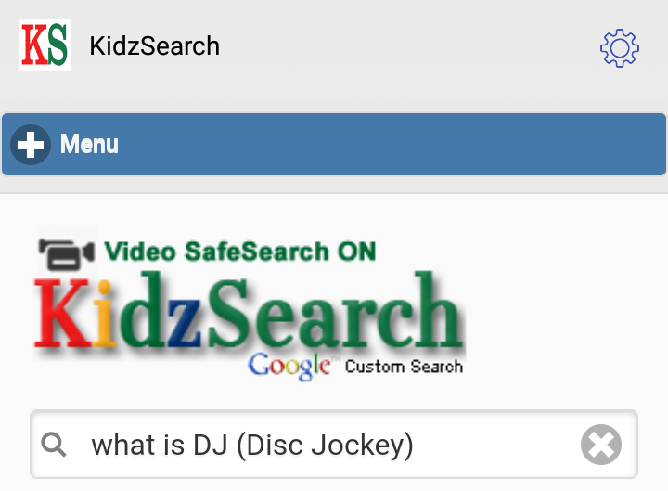
Kidssearch / Sana & Kubilay
kids search
DJ is what is known as DJ, which is an abbreviation of Disc Jockey, which means "the knight of records". It meanes the D J.

Slide 7
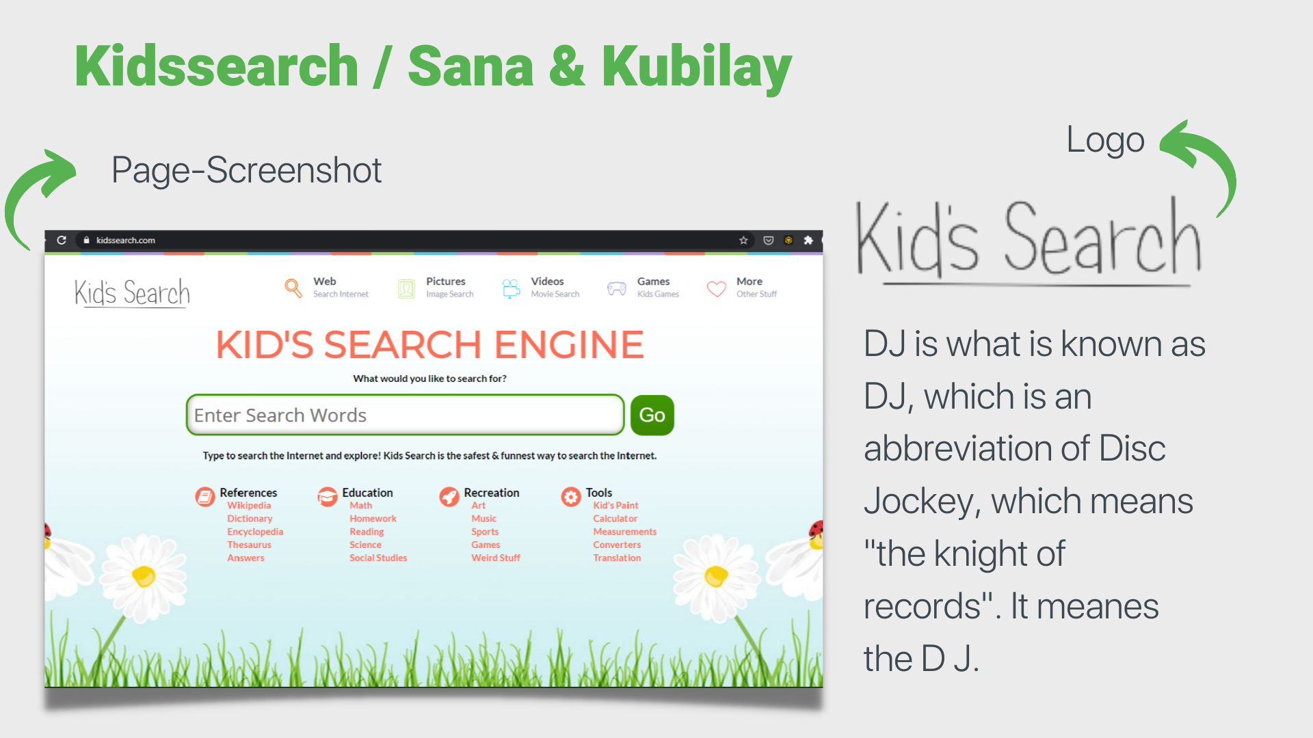

Slide 8

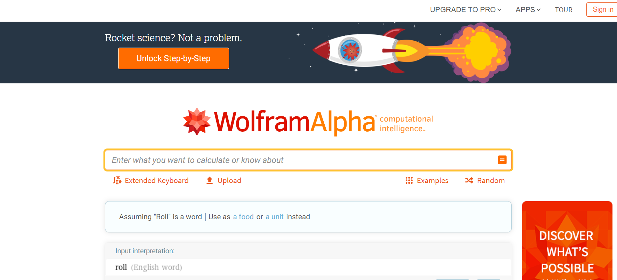
Wolfram Alpha / Nohaila (Jordan) & Nilüfer (Turkey)
Meaning of Roll: (Verb) Moving by turning or rotating
Link: https://www.wolframalpha.com/input/?i=Roll

Slide 9
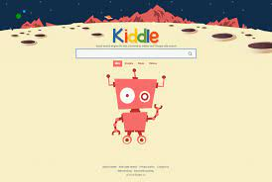
Kiddle / Özgen & Rogelio
Kiddle is a visual search engine for kids, offering safe kids web, image, and video search. Results are vetted by editors.
Bend:to cause to take on a curved or angled form, or on a different form.

Slide 10


Rosa & Marta
Ecosia is a search engine
Founder/Creator:Christian Kroll
Available in: Many languages
Launch date: December 7, 2009
Type of site: Search engine
Turnover: advertising
Current status: active
It is managed by the homonymous company Ecosia GmbH based in Berlin.
Ecosia - the search engine that plants trees
(intransitive verb) to walk with a loud heavy step usually in anger
The company claims to donate 80% of the proceeds from online advertising to support reforestation programs in various states around the world.
Ecosia.org is a certified B Corporation, which has “rigorous standards of social and environmental performance, accountability, and transparency.”

Slide 11


Gogooligans / Svetlana & Ancuta
GoGooligans is a search engine for kids and teens. Gogooligans.com incorporates a 7-step filtering/prevention process so that content is presented safely.
https://www.lures.info/childrens_search/gogooligans.html

Slide 12
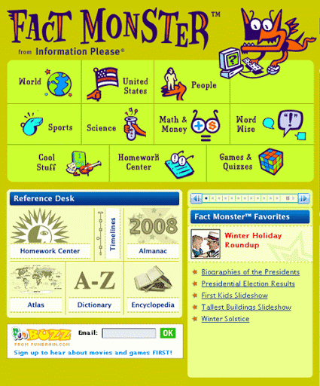

Fact Monster / Venera & Vizbulite
I

